Slide 1
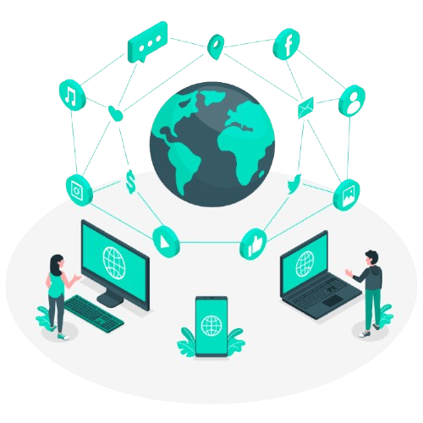

Computer Networks CS260

Slide 2
Roadmap
Project Proposal
Technology Stack
Potential Challenges
1
3
5
7
Summary
2
4
6
Project Overview
Design
Timeline

Slide 3

Project Proposal
1
Developing an Comprehensive Chat Application using Socket Programming

Slide 4
Proposal Overview
Create a desktop or web application to be deployed on end-user systems, enabling real time communication and data transfer.
The proposed application aims to feature:
Efficient communication between end users using TCP/IP protocols.
Serializing and deserializing data, which is used to implement data encapsulation and decapsulation.
Implement packet segmentation addressing using TCP/IP protocols.
A user friendly user interface for end users to use the application.
Implement socket programming for seamless communication between clients over the client server network

Slide 5

Technology Stack
2
To develop the project, the following technologies will be used:
Programming Languages: Python language
Programming Methodology: Socket Programming
Database: SQLite database(RDBMS), Firebase(NOSQL)
Frontend: Streamlit
API: FASTAPI for database connection
Virtual Environment: Venv for handling dependencies
Collaboration Tool: Git and Github

Slide 6

Front-End Design
3
User authentication page to allow users access to the chat room.
Display of previous chats in the chatroom.
Message feed input for the clients to share their messages.
Display of all client names in the chat room.

Slide 7

Challenges
Solutions
4
Adequate socket connections between clients and server
Frontend and database connection
Interactive GUI
Data encapsulation
Socket programming at the backend for smooth data transfer
Using SQLite database for smooth data storage.
Utilizing inbuilt libraries like Streamlit or pyqt6 for frontend
Encode message in JSON format for data encryption.

Slide 8

Project Timeline
5
The project is scheduled to be completed within a three-week timeframe, starting from November 15, 2024, to the project delivery date on December 1st, 2024. It comprises the following major milestones:
Research and Analysis: November 18th, 2024
Backend Development: November 23th, 2024
Front-end Integration: November 26th, 2024
Testing and Debugging: November 28th, 2024
Final Deployment: December 1th, 2024

Slide 9

Conclusion
6
This project aims to address the challenges inherent in modern chat application like miscommunication, obsolete frontend designs
By focusing on data encapsulation along the OSI model, we wish to obtain a clear understanding of how this is performed in socket programming
Through comprehensive research, thoughtful analysis, and agile development methodologies, we aspire to create an robust group chat application

Slide 10
THANKS!
Presented by:
Malik Saad Ahmad (231224) Moez-Ul-Haq (231136) Fraz Rasool (231202)

